Slide 1
Assessment for learning Unit -1 Basics of Assessment
By Dr. N. Mahendiran,Ph.D., Assistant Professor, Jaya College of Education,

Slide 2
Meaning of Measurement
Measurement is the assignment of a number to a characteristic of an object or event.
It can be compared with other objects or events.

Slide 3
Definition of Measurement
Measurement refers to the process of assigning numerals to events, objects etc. according to certain rules (Tyler, 1963).
Measurement is the assigning of numbers to things according to rules (Glass & Stanley, 1970).

Slide 4
Meaning of Assessment
Assessment plays a number of roles in the life of a student, some of which they may be more aware of than others.
Educational assessment is the process of documenting, usually in measurable terms, knowledge, skills, attitudes and beliefs.

Slide 5
Assessment
According to Evangeline Harris Stefankis (2002), “The word assess comes from the Latin, which means to set beside. Literally then, To assess means to sit beside the learner”.
According to Fenton (1996), “Assessment is the collection of relevant information

Slide 6
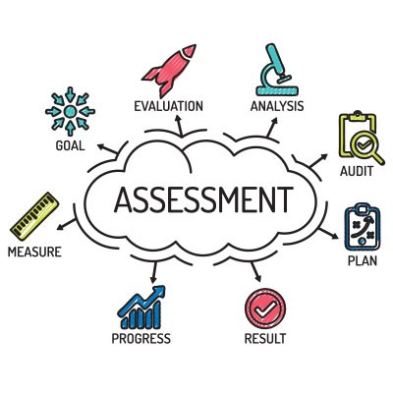
Definition of Assessment
Assessment does more than allocate a grade or degree classification to students – it plays an important role in focusing their attention and, as Sainsbury & Walker (2007) observe, actually drives their learning.

Slide 7
Gibbs (2003) states that Assessment has 6 main functions
1. Capturing student time and attention.
2. Generating appropriate student learning activity
3.Providing timely feedback which students pay attention to
4.Helping students to internalize the discipline’s standards and notions of equality
5.Generating marks or grades which distinguish between students or enable pass/fail decisions to be made
6.Providing evidence for other outside the course to enable them to judge the appropriateness of standards on the course. That may be relied on for making decisions.

Slide 8
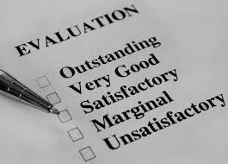
Meaning of Evaluation
Evaluation = Measurement + Judgement
Measurement tells quantity and evaluation refers to quality.
Measurement tells “how much” and evaluation tells “what value or worth that how much is”.

Slide 9
Definition of Evaluation
Evaluation is the process of delineating, obtaining and providing useful information for judging decision alternative (Stufflebeam).
Evaluation in education is a process by which we form judgment about the value of the educational status or achievement of students (Hill & Dressel).

Slide 10
Evaluation
Quantitative description of pupils’ achievement+ Qualitative description of pupils’ abilities+ Value judgements about achievements & abilities

Slide 11
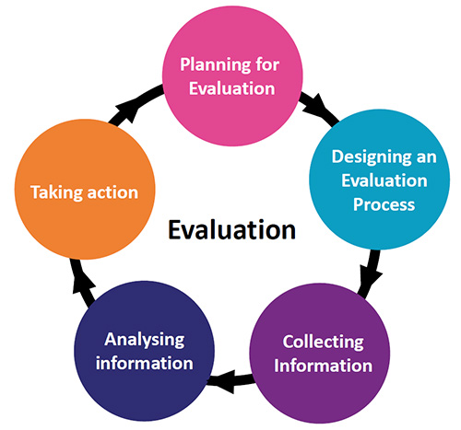
Principles of Evaluation
Comprehensive
Cooperative
Used Judiciously
Continuous & integral part of the teaching-learning process
Evaluation is forward looking process which provides guidelines for future improvement
Expertise is required in selection & construction of evaluation tools, its administration & analysis
Evaluation goes simultaneously with planning of educational programme

Slide 12
Relationship between Measurement & Evaluation
Evaluation goes beyond measurement in judging the desirability
Evaluation is not only quantitative but also qualitative & includes value judgements
Evaluation
Assessment
Measurement

Slide 13
Relationship between Measurement & Evaluation
Measurement describes a situation; evaluation judges its worth or value
Evaluation is a continuous and comprehensive process; Integral part of education (pupil & teacher are partners)
Evaluation signifies a wider process of judging students’ progress; Measurement quantitative assessment of instructional outcomes
Evaluation is integrated with the whole task of education & not only with measurement & examinations
Measurement is only a tool to be used in evaluation

Slide 14
Comparison Chart
BASIS FOR COMPARISON | ASSESSMENT | EVALUATION
Meaning | Assessment is a process of collecting, reviewing and using data, for the purpose of improvement in the current performance. | Evaluation is described as an act of passing judgement on the basis of set of standards.
Nature | Diagnostic | Judgmental
What it does? | Provides feedback on performance and areas of improvement. | Determines the extent to which objectives are achieved.

Slide 15
Comparison Chart
BASIS FOR COMPARISON | ASSESSMENT | EVALUATION
Purpose | Formative | Summative
Orientation | Process Oriented | Product Oriented
Feedback | Based on observation and positive & negative points. | Based on the level of quality as per set standard.
Criteria | Set by both the parties jointly. | Set by the evaluator.
Measurement Standards | Absolute | Comparative

Slide 16
Role of assessment in learning
Nature of assessment
Interconnected with curriculum & instruction
Achievement of curriculum outcomes
Continuous monitoring of students’ learning
Student’s progress
Provides opportunities for close observation of students in the process of learning
Frequent feedback
Impact on the self-esteem of pupils
Variety of strategies

Slide 17
Perspectives of Assessment
Assessment for learning
Assessment of learning
Assessment as learning

Slide 18
Assessment of learning
An activity to measure, record & report on achievement in regard to specific learning expectations
Accompanied by a number of letter grade
Compares one student’s achievement with standards
Results can be communicated to the student & parents
Occurs at the learning point

Slide 19
Assessment as learning
An activity to allow students the opportunity to use assessment to further their own learning
Self & peer assessments allow students to reflect on their own learning
To identify areas of strength & need
To set their own personal goals
To advocate for their own learning
Students become aware of the goals of instruction
Metacognition occurs throughout the learning process

Slide 20
Assessment for learning
Process of seeking & interpreting evidence for use by learners & their teachers
Students encouraged to be more active in their learning
Create self-regulated learning
Students guided for quality works
Teacher will work with the student to identify the gap
To adjust classroom instruction based according to the needs of the students
Verbal/written feedback emphasizes strengths, identifies challenges and point to next steps
No grades/scores
Record-keeping is primarily anecdotal & descriptive occurs throughout the learning process

Slide 21
Assessment for learning
Teachers
Plan & modify teaching & learning programmes for individual students, groups of students & the class as a whole
Pinpoint students’ strengths
Identify students’ learning needs in a clear & constructive needs
Involve parents, families in their children’s learning
Students
Lead from what has been learned to what needs to be learned next
Use a range of approaches
It includes
Day-to-day activities, such as learning conversations
A simple mental note taken by the teacher during observation
Student self & peer assessments
A detailed analysis of a student’s work
Tools may be written items, structured interview questions, or items teachers make up themselves

Slide 22
Assessment for learning
Assessment for Learning focuses on the opportunities to develop students' ability to evaluate themselves, to make judgements about their own performance and improve upon it. It makes use of authentic assessment methods and offers lots of opportunities for students to develop their skills through formative assessment using summative assessment sparingly.

Slide 23
Assessment for, as & of learning
For
Occurs when teachers use inferences about student progress to inform their teaching
As
Occurs when students reflect on & monitor their progress to inform their future learning goals
Of
Occurs when teachers use evidence of student learning to make judgements on student achievement against goals and standards

Slide 24
Assessment OF Learning vs Assessment FOR Learning
“When the cook tastes the soup, that’s formative assessment;
when the customer tastes the soup, that’s summative assessment”
- PAUL BLACK

Slide 25
Formative Assessment
Conducted throughout teaching and learning to diagnose student needs
Plan the next steps in instruction.
Provide students with feedback they can use to improve the quality of their work.
Help students see & feel how they are in control of their journey to success.

Slide 26
Formative Assessment
Taken at varying intervals throughout a course to provide information & feedback that will help to improve the:
A) quality of student learning
B) quality of the course itself
This assessment is about GETTING BETTER
Formative assessment comprise of classwork, homework, oral questions, quizzes, projects, assignments/tests.

Slide 27
Key elements of formative assessment
Identification by teachers & learners of learning goals, intentions or outcomes & criteria for achieving these
Rich conversations between teachers & students that continually build and go deeper.
Provision of effective, timely feedback to enable students to advance their learning.
Active involvement of students in their own learning.
Teachers responding to identified learning needs & strengths by modifying their teaching approaches.

Slide 28
Formative assessment
Little more complex.
Completed during development of programme (conducted more than once).
Research orient-intent is to improve.

Slide 29
Strategies (Formative Assessment)
Conference
Cooperating Learning Activities
Demonstrations
Graphic organizers
Interviews
Oral Attitude Surveys
Oral Presentations
Peer Assessment
Problem solving Activities
Questioning
Quiz
Self-Assessment

Slide 30
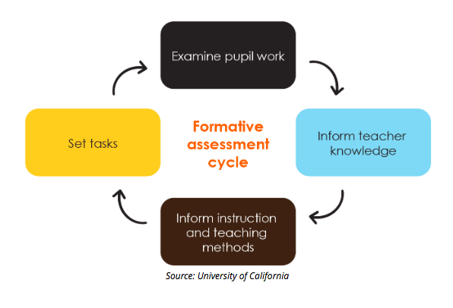

Slide 31
Summative Assessment
Term end examination.
Provide feedback on learning to teacher & parents.
Successful end product and /or the fulfilling of the pre-stated objective.
Assessment of learning.
To demonstrate the sum of what they have or have not learned.
Traditional way.
Designed to provide information.
Make judgement about student achievement.
Determines student’s mastery & understanding of information, skills, concepts or processes.

Slide 32
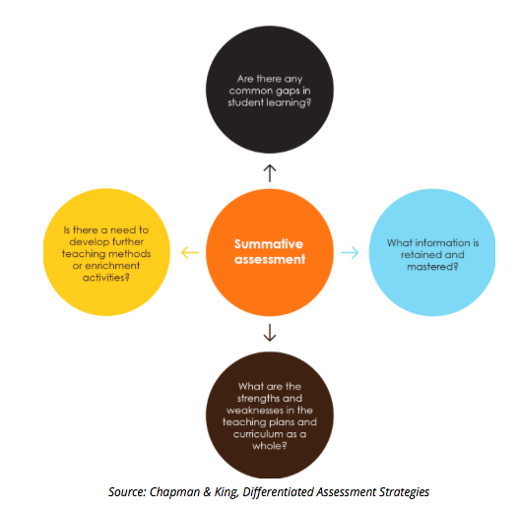

Slide 33
Purpose of Assessment
For Learning
To promote further improvement of student learning during the teaching learning process.
To involve students in the ongoing assessment of their own achievement.
Of Learning
To measure student achievement.
To sort students in rank order.
To maximize student learning through standardized tests, etc.

Slide 34
Functions of Assessment
Monitoring the Progress
Decision making
Screening
Diagnostic process
Placement of students in remedial courses
Instructional Planning
Evaluation of instructional programme
Feedback
Motivation

Slide 35
Assessment OF & FOR Learning
 | For Learning | Of Learning
Primary Users | Students Teachers Parents | Policy makers Program Planners Supervisors
Typical Users | Help students see & hit the target Help teachers identify & respond to student needs | Certify Competence Sort students according to achievement
Teacher’s Role | Inform students of targets Modify instruction Involve students in assessment | Follow test administration procedures Use results to help student reach GPS
Student’s Role | Strive to understand the target Act on classroom assessment to improve Encourage success | Study to meet standards Take the test Strive for the highest score possible Avoid failure

